Slide 1
Real-Time Sign Language Recognition
PROJECT PRESENTATION
American (ASL) and Indian (ISL) Sign Language to text and speech, in the browser
Animesh raj – 24126004
Gulshan kumar - 24126011
Mangalarapu sumanth - 24126026
[ELECTRICAL ENGINEERING ]
Notes:
Welcome and introduce the team. This project recognises a limited vocabulary of ASL and ISL signs from a webcam or an uploaded video and turns them into words, letters and a spoken sentence. Fill in the bracketed placeholders on this slide before presenting.

Slide 2
Problem Statement
Communication between sign language users and people who do not sign usually depends on a human interpreter. This project tests whether a webcam and an ordinary laptop are enough to translate signs into text and speech.
Input
Processing
Output
Live webcam or an uploaded video clip
Hand and body landmarks, decoded on the CPU
Words, letters, a sentence and speech
Sign Language Recognition (ASL + ISL)
2
Notes:
State the motivation: interpreters are not always available. Our approach uses only a webcam and runs locally on a laptop CPU. Walk through the three boxes: input, processing, output.

Slide 3
Objectives
1. Recognise two languages
2. Work in real time
Decode ASL and ISL words in a single dashboard, plus ASL fingerspelling.
Detect where a sign starts and ends automatically from the live camera feed.
3. Stay lightweight
4. Produce usable output
Run on a CPU with no GPU at inference time, using a word model of about 1.7 MB.
Build a sentence that can be copied or read aloud with text-to-speech.
Sign Language Recognition (ASL + ISL)
3
Notes:
Four objectives. Emphasise that the system is intentionally small and runs locally: the word classifier is a transformer of roughly 1.7 MB and needs no GPU for inference.

Slide 4
Scope: A Limited Vocabulary
23
51
28
ASL words
ISL words
ASL letter classes
Signs the ASL word model knows
Signs the ISL word model knows
A to Z, plus space and delete
Any sign outside these vocabularies is mapped to the closest known sign. No ISL letter model is included.
Sign Language Recognition (ASL + ISL)
4
Notes:
Be upfront about scope. We trained on a limited set of signs: 23 ASL words, 51 ISL words and the ASL alphabet with space and delete keys. The system does not translate arbitrary sentences; unknown signs are matched to the nearest known sign.

Slide 5
Vocabulary
ASL words (23)
ISL words (51)
bird, blue, cat, dad, dog, drink, go, green, happy, hello, home, hungry, like, mom, no, please, red, sad, sick, sleep, thankyou, water, yes
Examples: hello, thankyou, good, goodmorning, house, car, teacher, white
The full list of 51 signs is stored in models/isl_words.json.
Sign Language Recognition (ASL + ISL)
5
Notes:
Read out a few of the ASL words and a few of the ISL examples. The complete ISL list of 51 signs is in the repository file models/isl_words.json, so add more examples here if the panel asks.

Slide 6

System Architecture
Landmarks
Input
Segmenter
Classifier
Output
MediaPipe hands and pose, 67 points per frame
Webcam frame or uploaded video
Cuts the stream into individual signs
Transformer for words, MLP for letters
Top-3 words, sentence, speech
Word path
Letter path
Resample to 32 frames, normalise to the shoulders, run the transformer, return the top-3 words.
Track one hand, use wrist-centred features, run the MLP, type the letter once it is held steady.
Sign Language Recognition (ASL + ISL)
6
Notes:
Walk left to right. MediaPipe gives 67 keypoints per frame (pose points 0 to 24 plus 21 points on each hand); missing parts are stored as NaN. The WordSegmenter decides when a sign starts and ends. Words and letters then follow separate paths. The browser sends about 13 frames per second to a Flask server that does the tracking and decoding.

Slide 7
Technology Stack
Component | Technology | Role
Tracking | MediaPipe | Hand and body landmarks
Word model | 3-layer transformer | Trained in PyTorch, run in numpy
Letter model | MLP | Exported to numpy
Web server | Flask, Gunicorn | Live dashboard and API
Training | Kaggle, Colab | Keypoint files only
Hosting | Render | Optional web service
Sign Language Recognition (ASL + ISL)
7
Notes:
The word transformer is trained with PyTorch but exported to plain numpy for inference. The outputs match to about 1e-7 and use roughly 175 MB less memory, which is why the hosted version does not need PyTorch.

Slide 8
Datasets
ASL words
ISL words
ASL letters
Google Isolated Sign Language Recognition (asl-signs)
INCLUDE-50 subset from AI4Bharat
ASL Alphabet image dataset
28 classes, A to Z plus space and delete
23 signs selected for the model
About 955 videos, roughly 14 clips per sign
Only keypoints are stored for training. Each video is converted to landmarks and then deleted, which keeps the data small.
Sign Language Recognition (ASL + ISL)
8
Notes:
Three public datasets. The ISL model uses only the INCLUDE-50 subset, about 955 videos, so each sign has roughly 14 clips. The extraction script downloads only those videos (about 12 GB, never the full 56 GB archive), extracts keypoints and deletes each video. Datasets are credited on the final slide.

Slide 9
Models and Accuracy
86.3%
94.6%
ASL words, test top-1 (n=629)
ISL words, test top-1 (n=167)
Model | Classes | Validation top-1 | Test top-1 | Test top-3
ASL words | 23 | 92.2% | 86.3% | 95.4%
ISL words | 51 | 98.5% | 94.6% | 99.4%
Offline results on held-out clips from controlled datasets. Expect lower accuracy on a personal webcam, especially for ISL. No accuracy figure is reported for the letter model.
Sign Language Recognition (ASL + ISL)
9
Notes:
Top-1 means the correct word is the first prediction; top-3 means it is among the three suggestions shown to the user. Be honest about the caveat: these numbers come from held-out clips of the same controlled datasets used for training, so live webcam accuracy will usually be lower. ISL is trained on only about 14 clips per sign.

Slide 10
Dashboard Features
Live decoding
Video upload
Fingerspelling
A sign starts when the hands appear and ends when they leave the picture.
Decode a recorded clip as one sign or split it into several words.
Hold an ASL letter steady to type it.
Sentence builder
Framing check
Privacy
Confidence threshold, top-3 suggestions, undo, clear, copy and text-to-speech.
A landmark overlay and a warning when the shoulders are out of view.
Camera frames are processed in memory and uploaded videos are deleted afterwards.
Sign Language Recognition (ASL + ISL)
10
Notes:
This is a good slide to switch to a live demo. Show the language and mode toggles at the top, sign one word in auto mode, then show the top-3 suggestions and the sentence builder. The dashboard runs locally at http://localhost:5001.

Slide 11
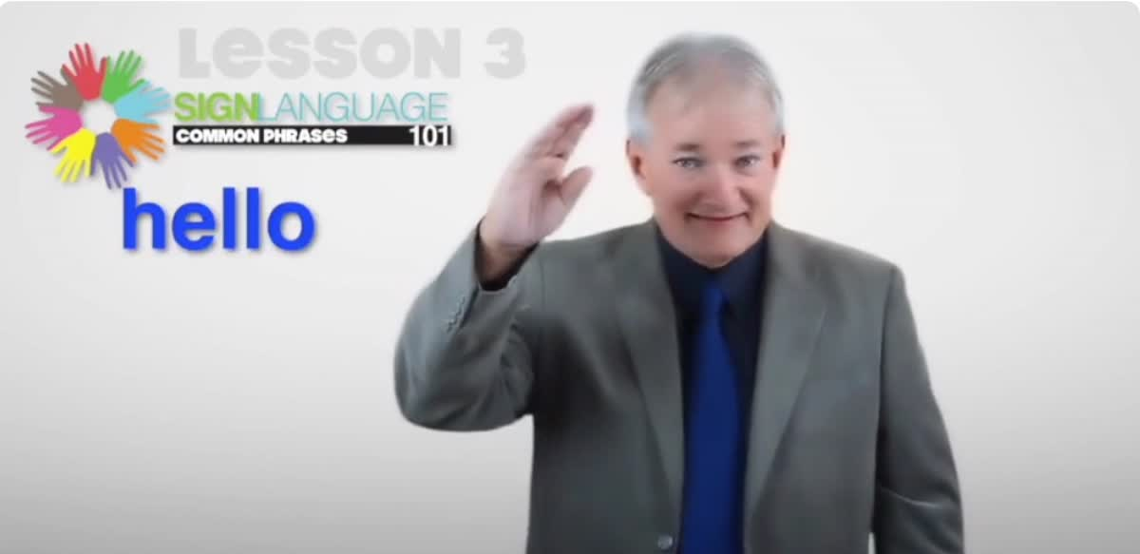
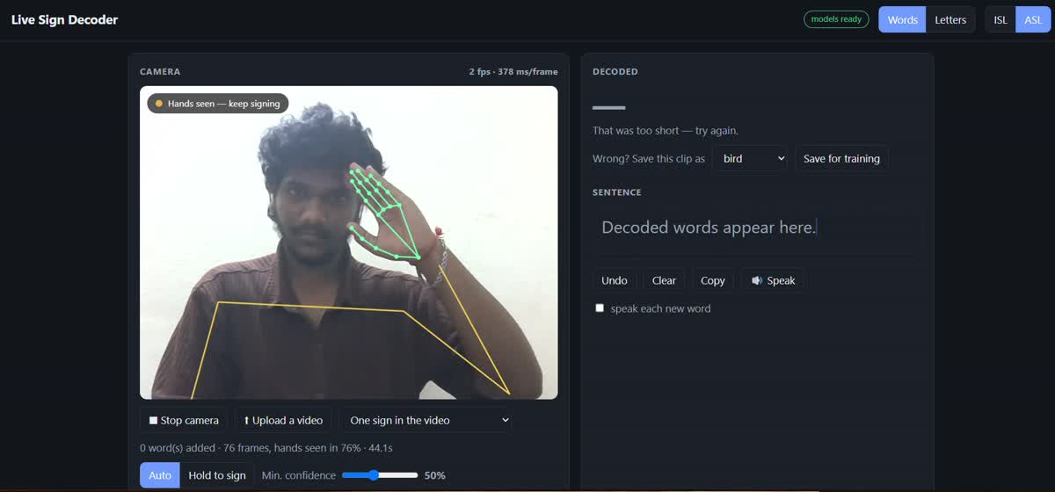
Demo: signing "hello"
REFERENCE SIGN (ASL)
OUR LIVE DECODER
A tutorial clip showing the standard ASL sign for "hello": a flat hand at the forehead, moving outward.
The same sign recorded on the dashboard, with the hand and shoulder landmark overlay drawn live.
Same sign, two sources: a tutorial reference and our webcam recording.
Sign Language Recognition (ASL + ISL)
11

Slide 12
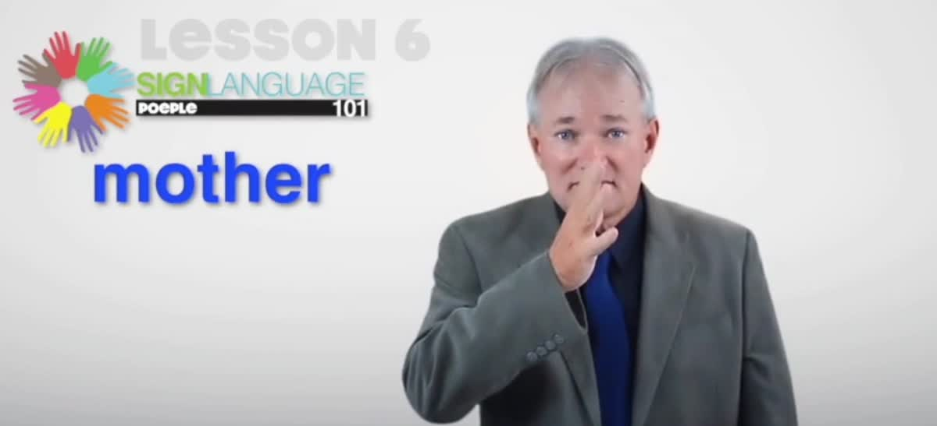
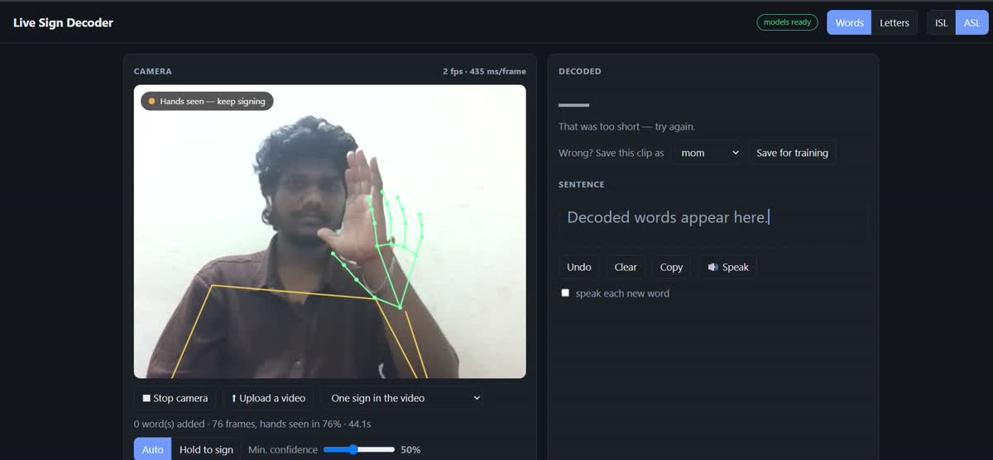
Demo: signing "mom"
REFERENCE SIGN (ASL)
OUR LIVE DECODER
A tutorial clip showing the ASL sign for "mother": the thumb of an open hand taps the chin.
Our dashboard recording of the same word. "mom" is one of the 23 ASL words in the model.
Same sign, two sources: a tutorial reference and our webcam recording.
Sign Language Recognition (ASL + ISL)
12

Slide 13
Training and Deployment
1
2
3
4
Extract
Train
Export
Deploy
Convert dataset videos and images into keypoint files on Kaggle.
Train the ASL and ISL word models in notebooks; ISL needs only minutes on a GPU.
Convert the PyTorch weights to numpy so PyTorch is not needed to run.
Run locally, or host as a Render web service using about 300 to 360 MB of memory.
Accuracy improves with your own data: save 5 to 10 corrected clips per word from the dashboard, retrain and replace the models.
Sign Language Recognition (ASL + ISL)
13
Notes:
Training is done on Kaggle or Colab and only small keypoint files are involved. After retraining, run tools/export_words_np.py to convert the weights for the server. Running locally is more reliable for demos because the hosted version sends every frame to the server.

Slide 14
Limitations
Area | Limitation
Vocabulary | Only 23 ASL and 51 ISL words, so unknown signs map to the nearest known sign
Training data | Controlled datasets; ISL has only about 14 clips per sign
Real-world accuracy | Expected to be lower on a personal webcam than the offline results
Letters | ASL fingerspelling only; no ISL letter model
Camera setup | Needs good light, both shoulders and both hands in view
Hosting | One user at a time and slower than running locally
Sign Language Recognition (ASL + ISL)
14
Notes:
Presenting limitations openly shows an understanding of the system. The word model measures hand positions relative to the shoulders, which is why the shoulders must stay in view. The hosted server keeps a single shared detection session, so concurrent visitors would interfere with each other.

Slide 15
Future Work
Record more data
Expand the vocabulary
Collect clips from many signers and webcams, then retrain.
Add more ASL and ISL signs beyond the current 23 and 51.
Add ISL fingerspelling
Support more users
Train an ISL letter model, which is not included today.
Replace the single shared session so several people can use a hosted version.
Sign Language Recognition (ASL + ISL)
15
Notes:
These are proposed next steps that follow from the limitations on the previous slide. Edit this list to match what your team actually plans to do.

Slide 16
Conclusion
A lightweight, browser-based recogniser for a limited set of ASL and ISL signs, running on a laptop CPU.
Two languages
Promising results
Clear next steps
23 ASL words, 51 ISL words and ASL letters
86.3% and 94.6% test top-1 on held-out clips
More data, more signs and ISL letters
Sign Language Recognition (ASL + ISL)
16
Notes:
Summarise in one breath: two languages, a deliberately limited vocabulary, a lightweight CPU-only design, strong offline accuracy and an honest view of the limits. Then move to questions.

Slide 17
Thank you
Questions and discussion
Acknowledgements
MediaPipe hand and pose landmarkers (Google). INCLUDE Indian Sign Language dataset (AI4Bharat). Google Isolated Sign Language Recognition (asl-signs). ASL Alphabet and ISL fingerspelling image datasets.
github.com/Gulshan-heap/sign-language
17
Notes:
Thank the panel, credit the datasets and tools, and invite questions. The repository link is in the footer.

